Slide 1
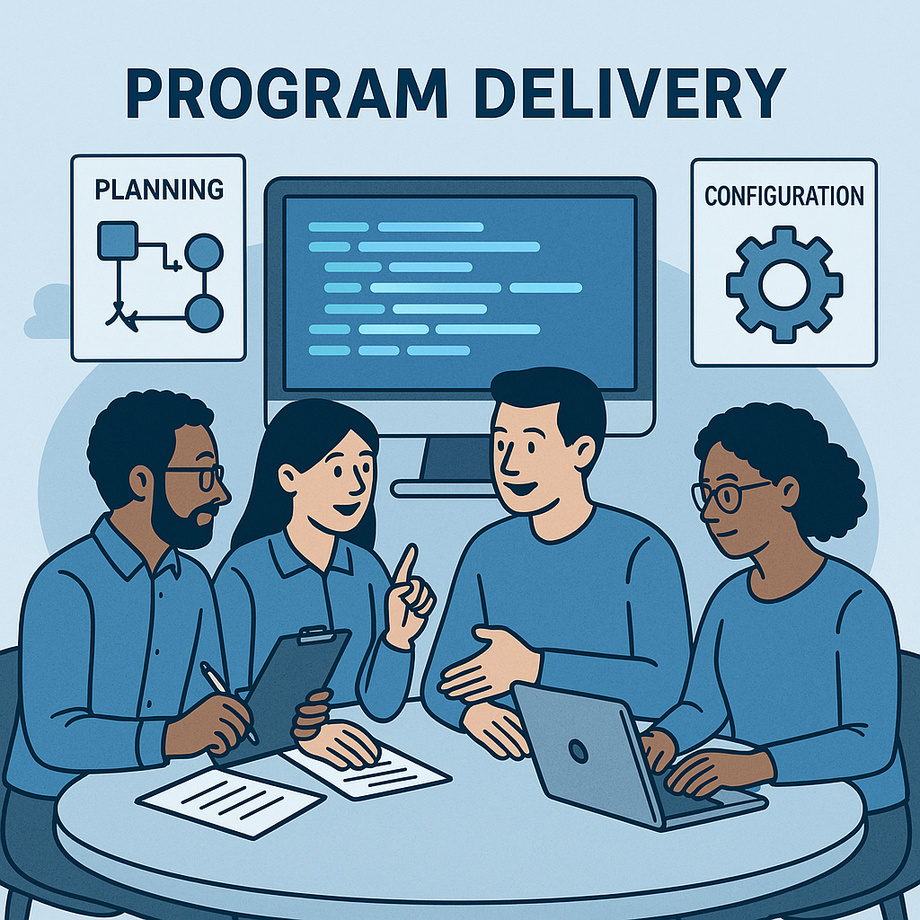
Program Delivery
Case Studies
March 2025
Confidential and Proprietary

Slide 2
Client Case Studies – Professional Services
Case Study: Legacy Payroll System Support
The client has relied on a legacy payroll application and associated systems since the early 1990s. While the system has been dependable, evolving regulatory obligations, technological advancements, and increasing expectations for reporting, costing, accountability, and auditing required significant upgrades. To maintain compliance with Australian statutory requirements and modern business standards, the client sought a partner who could manage and modernise their payroll infrastructure while ensuring uninterrupted operations.
Mivada has supported the client with Application Management Services (AMS) for over 10 years, delivering 24/7 technical support across the entire payroll ecosystem. This includes managing upstream and downstream interfaces, nightly batch processes, pay runs, security access, and satellite systems such as Qlikview, QCP, and Opswise (Universal Automation Center by Stonebranch).
Our approach to managing and enhancing the client’s legacy payroll environment is grounded in reliability, proactive issue resolution, and strategic improvement. We ensure critical daily operations run smoothly while identifying opportunities for modernisation, improved compliance, and performance optimisation.
Our technical expertise spans:
Database Management: Proficient in MS SQL Server and MySQL Server, including complex queries, stored procedures, views, and database maintenance.
Reporting Tools: Implementation and support of Qlikview for advanced reporting capabilities.
Payroll Application: Management of version upgrades, enhancements, EOFY processes, and tier 1, 2, and 3 support including security.
Infrastructure Support: Building and maintaining QCP servers, applying vulnerability patches, and performing system upgrades.
Scripting and Automation: PowerShell scripting for file translation (e.g., XML to CSV) supporting Single Touch Payroll (STP), and Python scripting to transform data from external systems into the payroll platform.
Legacy System Enhancements: Microsoft Access and Excel VBA development for custom tools and support.
Job Scheduling: Configuration and maintenance of job scheduling tools such as Opswise (UAC).
Ad-hoc Resourcing: Provision of project management and business analysis resources when required by the client.
Governance and Compliance: Ticket management via SNOW and Zendesk, and support for annual system audits.
In addition to technical services, Mivada has delivered value-added support to the client's payroll department, even outside the scope of the original support agreement, demonstrating our commitment to partnership and long-term success.
Major Project Successes - Mivada has played a central role in delivering several high-impact initiatives for the client, including:
Implementation of STP1 and STP2: Providing end-to-end technical support to meet the Australian Taxation Office’s Single Touch Payroll legislative requirements.
Cloud Migration: Supporting the successful migration of infrastructure and services to a cloud-based platform, increasing system resilience and scalability.
Superannuation Reporting Enhancements: Upgrading reporting capabilities to meet the evolving requirements of external superannuation providers.
COVID-19 Response: Delivering rapid system changes and support to facilitate government programs such as JobKeeper, as well as International and Domestic Retention Payments (IRP and DRP), ensuring accurate processing and compliance during a period of unprecedented change.
Mivada’s deep technical expertise, long-standing partnership, and flexible, value-driven support have enabled the client to maintain and modernise their critical payroll systems. We continue to ensure their systems not only meet current operational needs but are also prepared for future regulatory and technological developments.

Slide 3
Client Case Studies – Professional Services
Aviation Client
Payroll AMS Services
Purpose
To manage a legacy payroll application in a complex and challenging environment, enabling services to support the organisation by allowing them to focus on their core business activities while ensuring their payroll software application is secure, up-to-date, and performing optimally
Mivada has been the AMS support for more than 10 years and with a team of experts monitoring and providing support to the client as and when needed
Our Approach
The ‘adaptive’ application managed services model (DevOps model) works ensuring surety of costs, with the right levels of service, knowledge, and continuity without extra administration and incremental costs associated with regular enhancements and change requests.
How we do it
Moved the organisation’s legacy on premise payroll application to a cloud environment ensuring a smooth transition with minimal disruption to business operations.
Provide continuous support and maintenance for the payroll application to ensure it runs smoothly and efficiently. This includes troubleshooting issues, applying security and legislative patches, performing regular upgrades and configuration of new requirements.
Manage the security of the application, user management, monitor vulnerabilities and protect against cyber threats
Successfully implementing best practice and cost-effective Application Management Services maximizing the clients HR/Payroll investments
Outcome

Slide 4
Client Case Studies – Professional Services
Aviation Client
Customer Points Finance Solution
Challenge
Client launched a new points flight redemption product. This was a blend of the current redemption product and a Commercial flight booking. Given the hybrid nature of the product, there were multiple gaps in reporting, where if a combined booking was made with a Commercial segment, the current reporting could not differentiate between the two, hence could not financially account and report on the products correctly. GST was also a gap due to way the fares are filed.
Our Approach
Working with the solution architect, an initial discovery was performed on the current AS-IS reporting data flow, from the booking data, to the revenue and points accounting systems and where data were stored.
From this discovery, we determined that based on certain data points, we could back solve the amounts and points in order to differentiate it from a Commercial booking. Reporting was then designed, developed and deployed as an interim solution to aid in the month end accounting process to split products and manually calculate the GST if applicable.
Retail Food Services Client
Payroll AMS Services
Challenge
Employees often receive multiple staff numbers, and/or transitioning from contingent to permanent roles, requiring their learning histories to be transferred to their new profiles—a process not automatically handled by existing systems.
Our Approach:
Summary of what we did and what roles we played
We developed a system that generates custom reports to retrieve learning histories over specified date ranges. This integration then utilizes the 'Put Learning Enrollment' function to transfer these records to the new staff numbers, ensuring continuity in learning management.
Outcome: (what did our participation accomplish)
Compliance in maintaining learning history
100%
Compliance with internal accounting and reporting policies and external taxation legislation
Reduced administrative overheads and uninterrupted access to learning histories to support ongoing development and compliance
Outcome

Slide 5
Client Case Studies – Professional Services
Airport Services Client
People Systems review and recommendations
Challenge
The current People systems (HR, Payroll, and Time & Attendance) had not been updated in many years. To address gaps, a variety of ad-hoc manual processes and third-party tools have been used in the business, posing compliance and security risks. Given the minimal investment in upgrading these systems over the years, they are reaching end of life technology and there was no existing roadmap for future improvements or the replacement of these systems
Our approach
Detailed Discovery & Requirements Articulation – improve efficiency, document current processes and assess them against best practices including the creation of proposed to-be processes with new systems, technology and integration. Define functional and non-functional requirements, review current solutions and document issues, identify quick wins, review other systems across the group, and create a risk profile for non-compliance
Solution Options Assessment & Architecture – prepare a solutions options pack for a new People system, map alternative solutions to identify overlaps, determine different options to reduce duplication, manual processing and simpler integration, consider alternative implementation roadmaps, and assess against target state principles to select the preferred vendor combination for the go-forward
Recommendation, Plan & Business Case - Document architecture and People systems recommendations for the Executive Team. Build an implementation roadmap and timelines, highlighting dependencies on group systems. Create a detailed plan for the next phase and complete a high-level investment case, including a proposal for quick wins and detailed design
Value Add
Current Processes
Risk Assessment
As-Is and To-Be process maps for Onboarding
New technologies, integration and HCM recommendations
Compliance, Accuracy, Transformation
Recommendation for remediation, automation technology and HCM implementation including HR, Payroll, T&A
Outcome

Slide 6
Client Case Studies - Aviation Client (Payroll)
Re-Platform Payroll Solution
Challenge
Migrate the payrolll system from an IBM Mainframe to a Microsoft Windows platform consisting of two distinct parts:
Migration of the core payroll application to Windows
Migration of the client’s bespoke mainframe components
Our Solution
A step change in technology to effectively control the payroll environment, mandate automation and standardise business processes
De-risk the supportability of the payroll technology environment
Migrate the payroll system to Microsoft Windows platform
Outcome
Significant customer savings, run costs, employee headcount and new technologies introduced to the client including self service capability, integrated leave management and integrations
Superannuation Remediation
Challenge
To correct superannuation rules configuration in the payroll system resulting in inaccurate information being provided to the superannuation fund
To correct business process issues performed by the Payroll team in the treatment of the definitions of super calculations
Our Solution
Document AS-IS superannuation calculations to determine the errors to support the TO-BE calculations
Document AS-IS business processes to identify gaps and create the TO-BE
Configure additional screens and tables in the payroll system to capture additional employee and superannuation data to support the calculations
Outcome
Configuration of correct superannuation calculations in the payroll system for both Defined Benefits and Accumulation schemes. Calculations align with Super fund rules, Enterprise Agreements and Company Policy
LSL Remediation
Challenge
To correct errors in the calculation and payment of long service leave entitlements to employees which shall involve identifying underpayments or overpayments and ensuring that employees receive the correct anof leave or compensation they are entitled to
Our Solution
Configuration of an LSL Remediation and Compliance database that shall include all LSL calculations as per State/Territory and Company Policy
Development of Business Intelligent dashboards for real-time reporting, accurate data analysis, compliance and audit requirements
Outcome
The remediation process included reviewing the payroll systems, identifying affected employees, and making the necessary payments to correct the errors
Improved sustainability of the payroll environment and places client in a better position for Payroll Transformation
Successful remediation of 12 years of superannuation data including underpayments
The LSL Remediation and Compliance database enhances the accuracy, compliance, and efficiency of managing long service leave calculations
100%
100%
100%

Slide 7
Client Case Studies – Professional Services
Insurance Client
UKGPro Implementation Support
Challenge
The organisation faced significant challenges in meeting its legal obligations to ensure all employees were being paid correctly as per their EA. There was a need to demonstrate compliance by governing, controlling, and auditing T&A data and entitlement interpretation. The lack of automation and standardisation in entitlement interpretations and payment reconciliation lead to a high volume of manual out of cycle payments, increasing the risk of errors and inefficiencies. Additionally, the employee experience was not streamlined and fell short of industry practices, which impacted overall satisfaction and productivity. Addressing these challenges was crucial for improving compliance, accuracy, overall employee experience and meeting the Fair Work Ombudsman directives
Our approach
Reviewed and provided recommendations of their current group policies and business rules to align with pay entitlements according to the EA.
Supported the client in the end-to-end interpretation of the EA whilst at the same time applying the functional and technical requirements to ensure the solution met each clause in the EA
Developed Transformation logic and tools to support the implementation of UKG Pro. Completed the transformation activities to prepare and update data in SuccessFactors in readiness for implementation cutover.
Co-designed the solution and the rollout strategy with IAGs platform implementation partner, the Project Change Team and key business representatives to help meet its delivery success criteria
Value Add Input
Time & Attendance Expertise
Award Interpretation
Data Transformation
Payroll
Expertise

